Slide 1
Burn and Blame
Perceived wildfire causation and
posttraumatic stress symptoms
Soheil Shapouri, Rachel Connolly, Claire Bekker,
David Eisenman, Miriam Marlier, Dana Rose Garfin
University of California, Los Angeles

Slide 2
CME financial disclosure
In the past 24 months, I, Soheil Shapouri, have not had financial relationships with any ineligible companies.
Research support
National Center for Advancing Translational Science (NCATS), NIH
UCLA Clinical and Translational Science Institute
Grant UL1TR001881

Slide 3

Disasters and Mental health
Eight times greater odds of probable PTSD and depression
(Mulchandani et al., 2020)
Even 8 – 10 months after disasters, higher rates of depression, anxiety, and PTSD
(Gökkaya et al., 2025)

Slide 4
Disasters and Mental health
Demographics
Exposure
Perceived cause

Slide 5
Disasters and Mental health
Demographics
Exposure
Perceived cause
Age: children and adolescents and adults over 65 being particularly vulnerable
(Peek et al., 2017; Oh et al., 2025)

Slide 6
Disasters and Mental health
Demographics
Exposure
Perceived cause
Direct exposure(e.g., losing a loved one)
Proximate exposure(e.g., damage to neighborhood assessed by number of FEMA claims)
Disaster-related media exposure
(Garfin et al., 2022; Sackey et al., 2023; Merdjanoff et al., 2022)

Slide 7
Disasters and Mental health
Demographics
Exposure
Perceived cause
Natural
or
Human-made (technological)
???

Slide 8
Disasters and Mental health
Natural
Vs
Human-made
Hurricane Harvey as natural, human-made, or a combination of both
(Slack et al., 2020)

Slide 9
Natural vs. Human-made
Ancient threats (snakes and spiders)
Vs
Modern threats (guns and bombs)
(Shapouri & Martin, 2022)
Evolutionary psychology

Slide 10
Natural vs. Human-made
Ancient threats → Amygdala
Vs
Modern threats → Frontal cortex
Evolutionary psychology

Slide 11
Natural vs. Human-made
Anecdotal reports
three-mile island nuclear accidents vs cyclone Tracy
Baum et al. (1983)
Human-made disasters have longer, stronger psychological impacts than natural disasters
Public heath

Slide 12
Natural vs. Human-made
Anecdotal reports, lab experiment, archival study
(Baum et al., 1983; Siegrist & Sütterlin, 2014; Shapouri et al., 2023)
Not tested in the context of an actual climate disaster
Public heath

Slide 13
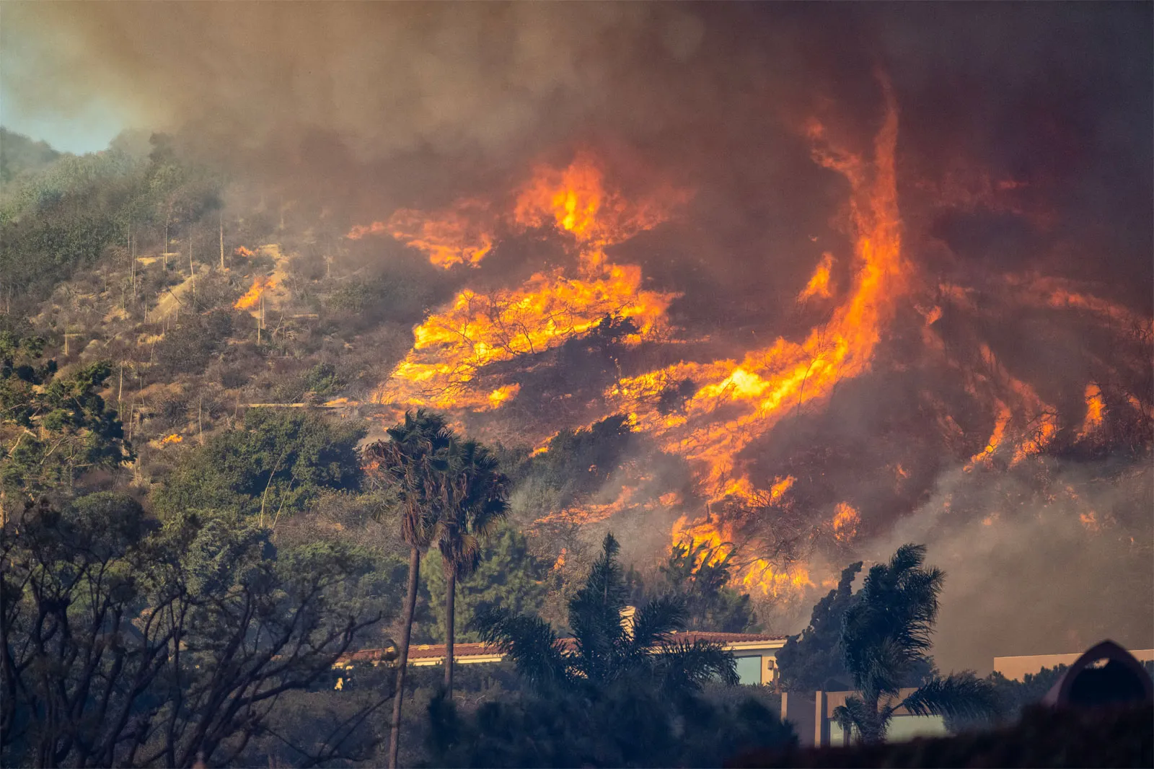
Los Angeles Fires of 2025
Palisades and Eaton fires ignited in Los Angeles County
The most destructive wildfire disaster in the county's history (Woolcott, 2025)
Lack of preparedness at individual, county, and state level

Slide 14
Recruitment and Study Timing
January-April 2026
Survey approximately 12-15 months after the fires
Multidisciplinary team in collaboration with LA fires community advisory board
February-September 2025
UCLA Wildfire Impacted Communities Registry
3,863 invited 1,189 completed (30.8%)

Slide 15
Sample
Characteristic | Statistic
Participants | 1,189
Mean age (SD) | 54.7 years (16.0)
Women | 726 (61.1%)
White | 768 (64.6%)
College degree or postgraduate | 925 (77.8%)
Median household income category | $150,000-$199,999

Slide 16
Perceived cause
Entirely human-caused
Mostly human-caused
Equally caused by humans and natural processes
Mostly natural processes
Entirely natural processes
“To what extent do you think wildfires are caused by human activities (e.g., accidents, arson, power lines) versus natural processes (e.g., lightning, drought, high winds)?”

Slide 17
Few participants chose natural causes
Human
498 (48.3%)
Equal
488 (47.4%)
Natural
44 (4.3%)
N = 1,030

Slide 18
Mental health outcomes
Demographics Age, Gender, Education, Race, Income
Self-reported evacuation
Official evacuation zones based on their addresses
Exposure
Posttraumatic stress symptoms
Depression
Anxiety
Modified PC-PTSD-5
PHQ
GAD

Slide 19
Adjusted regression models
Comparison
Perceived cause as predictor, PTS as outcome
Covariates
Age, gender, race, education, income, and evacuation
Inference
Linear regression with HC3 robust standard errors
N = 636

Slide 20
Lower PTS in the equal and natural groups
Reference group: human-caused
Equal causes
-0.85
[-1.61, -0.09]
Natural causes
-1.90
[-3.17, -0.62]
-4
-3
-2
-1
0
1
Adjusted difference in PTS score
Points show b. Lines show HC3 95% confidence intervals.

Slide 21
Additional analyses
Sensitivity analysis
Official evacuation zones → Same pattern
Natural and equal groups had lower PTS scores.

Slide 22
Additional analyses
Depression or anxiety
No significant association between perceived cause and depression or anxiety

Slide 23
What might explain the association between PTS and perceived cause?
Mechanisms remain untested
Possible emotional pathways
Stronger negative emotions in response to technological disasters
(Shapouri et al., 2023)
Anger or fear could link perceived causes with persistent symptoms.

Slide 24
Take-home message
How survivors make sense of why a trauma happened matters for recovery.
PTSD after disasters is partly shaped by perceived caused as natural or human-made.

Slide 25

Acknowledgment
UCLA
Rachel Connolly, Claire Bekker, David Eisenman, Miriam Marlier, Dana Rose Garfin, Elizabeth Choa, Grace Bryant
UC Irvine
Roxane Silver Cohen, Alison Holman, Kayley D. Estes, Tiffany Junchen Tao
Community partners
LA fires community advisory board

